Slide 1
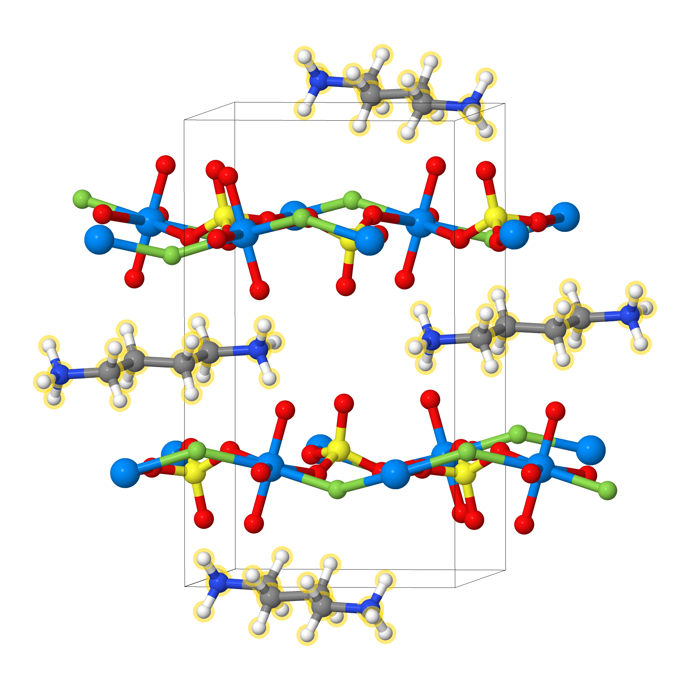
Chemical Composition
C0.105 H0.368 N0.053 F0.053
O0.316 S0.053 U0.053
Structure
Composition vector
C | … | H | …
0.105 | 0 | 0.368 | 0
Chemical System
C H N F O S U

Slide 2
A
Augmented CycleGAN
B

Slide 3
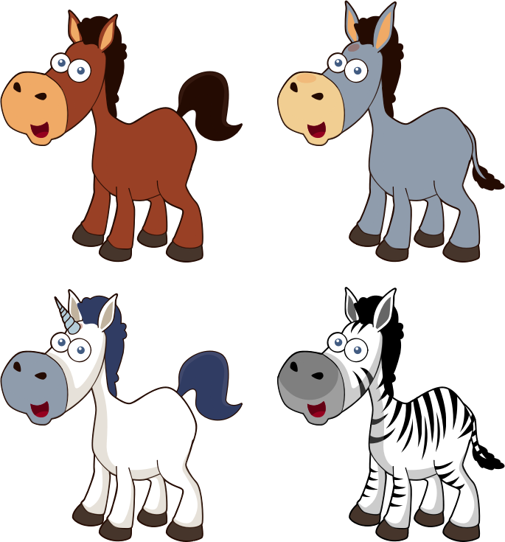
Augmented CycleGAN
Latent Z_{b}
Latent Z_{a}
C0.105 H0.368 N0.053 F0.053
O0.316 S0.053 U0.053

Slide 4
Image translation
(CycleGAN)
Composition translation
(Augmented CycleGAN)
Latent Z_{b}
Latent Z_{b}
C0.118
H0.412
N0.059
O0.353
U0.059
C ?
H ?
N ?
O ?
U ?

Slide 5


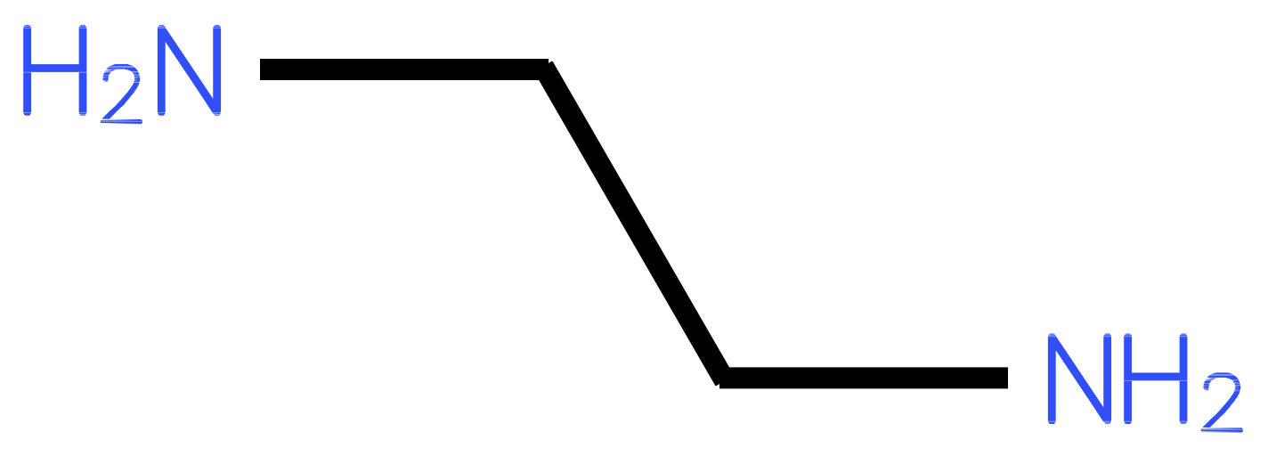
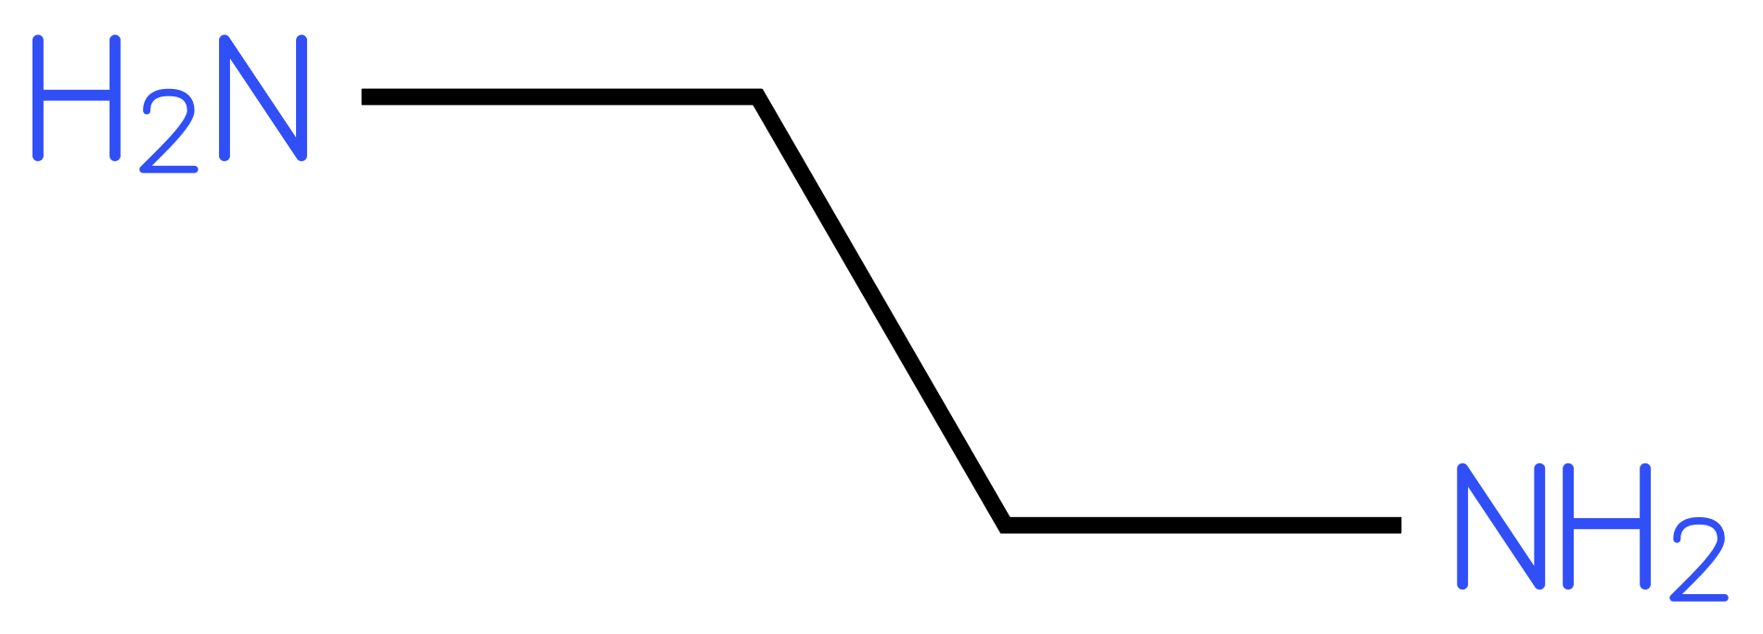
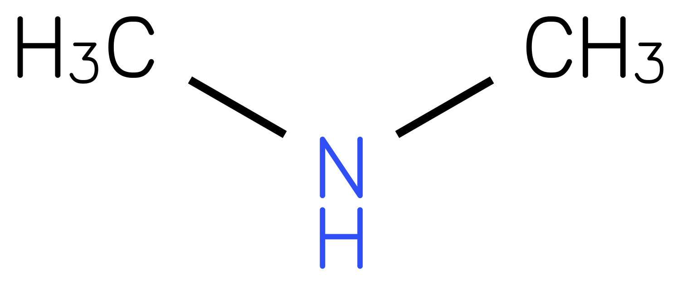
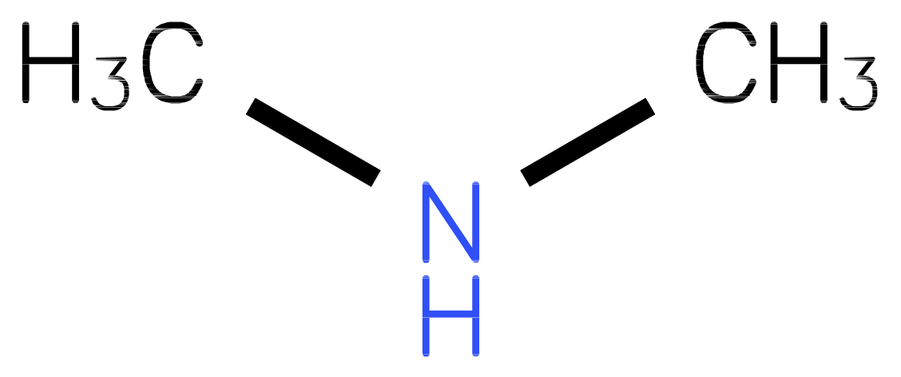
Image translation
(CycleGAN)
Composition translation
(Augmented CycleGAN)
Latent Z_{b}
Latent Z_{a}
C0.118 H0.412
N0.059 O0.353
U0.059
C? H?
N? O?
U?
Horse
Zebra
Amine-directed metal oxides

Slide 6
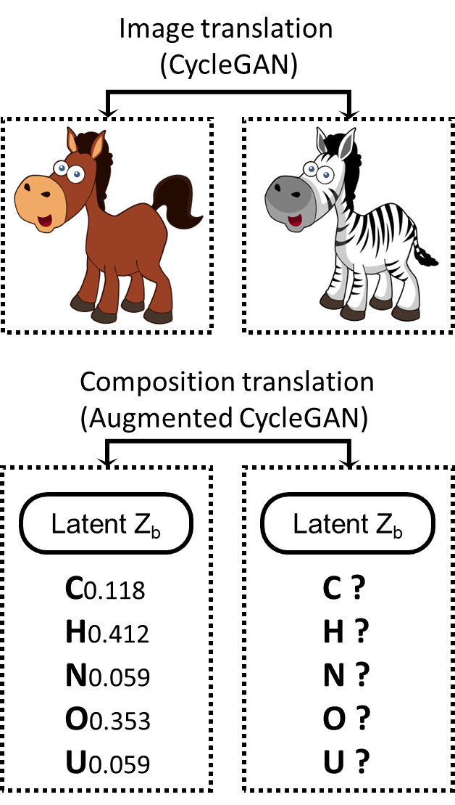

Slide 7
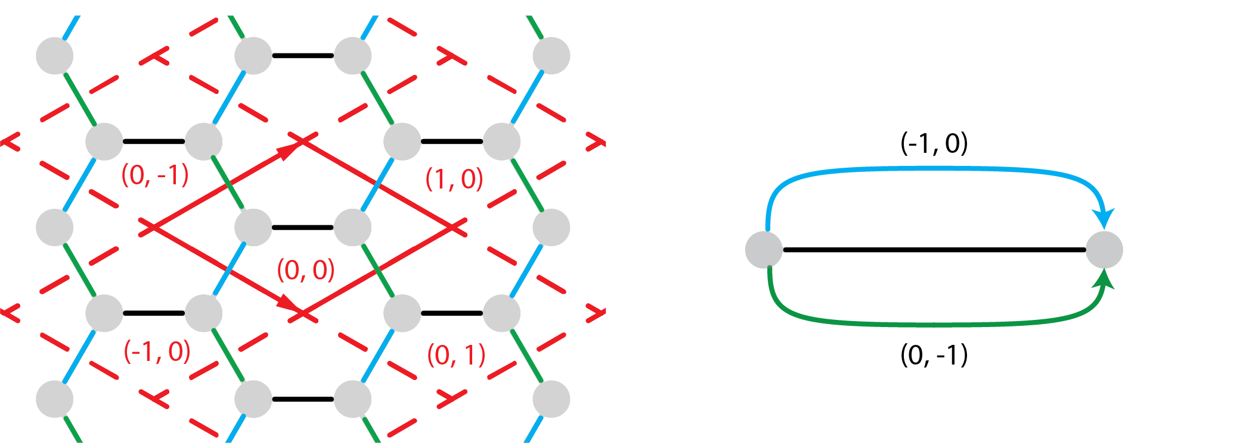
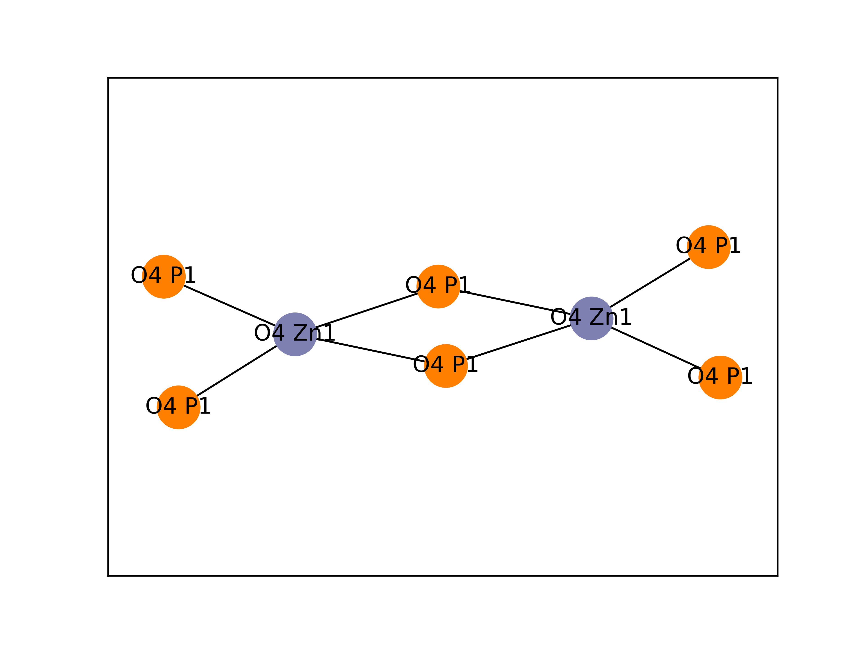
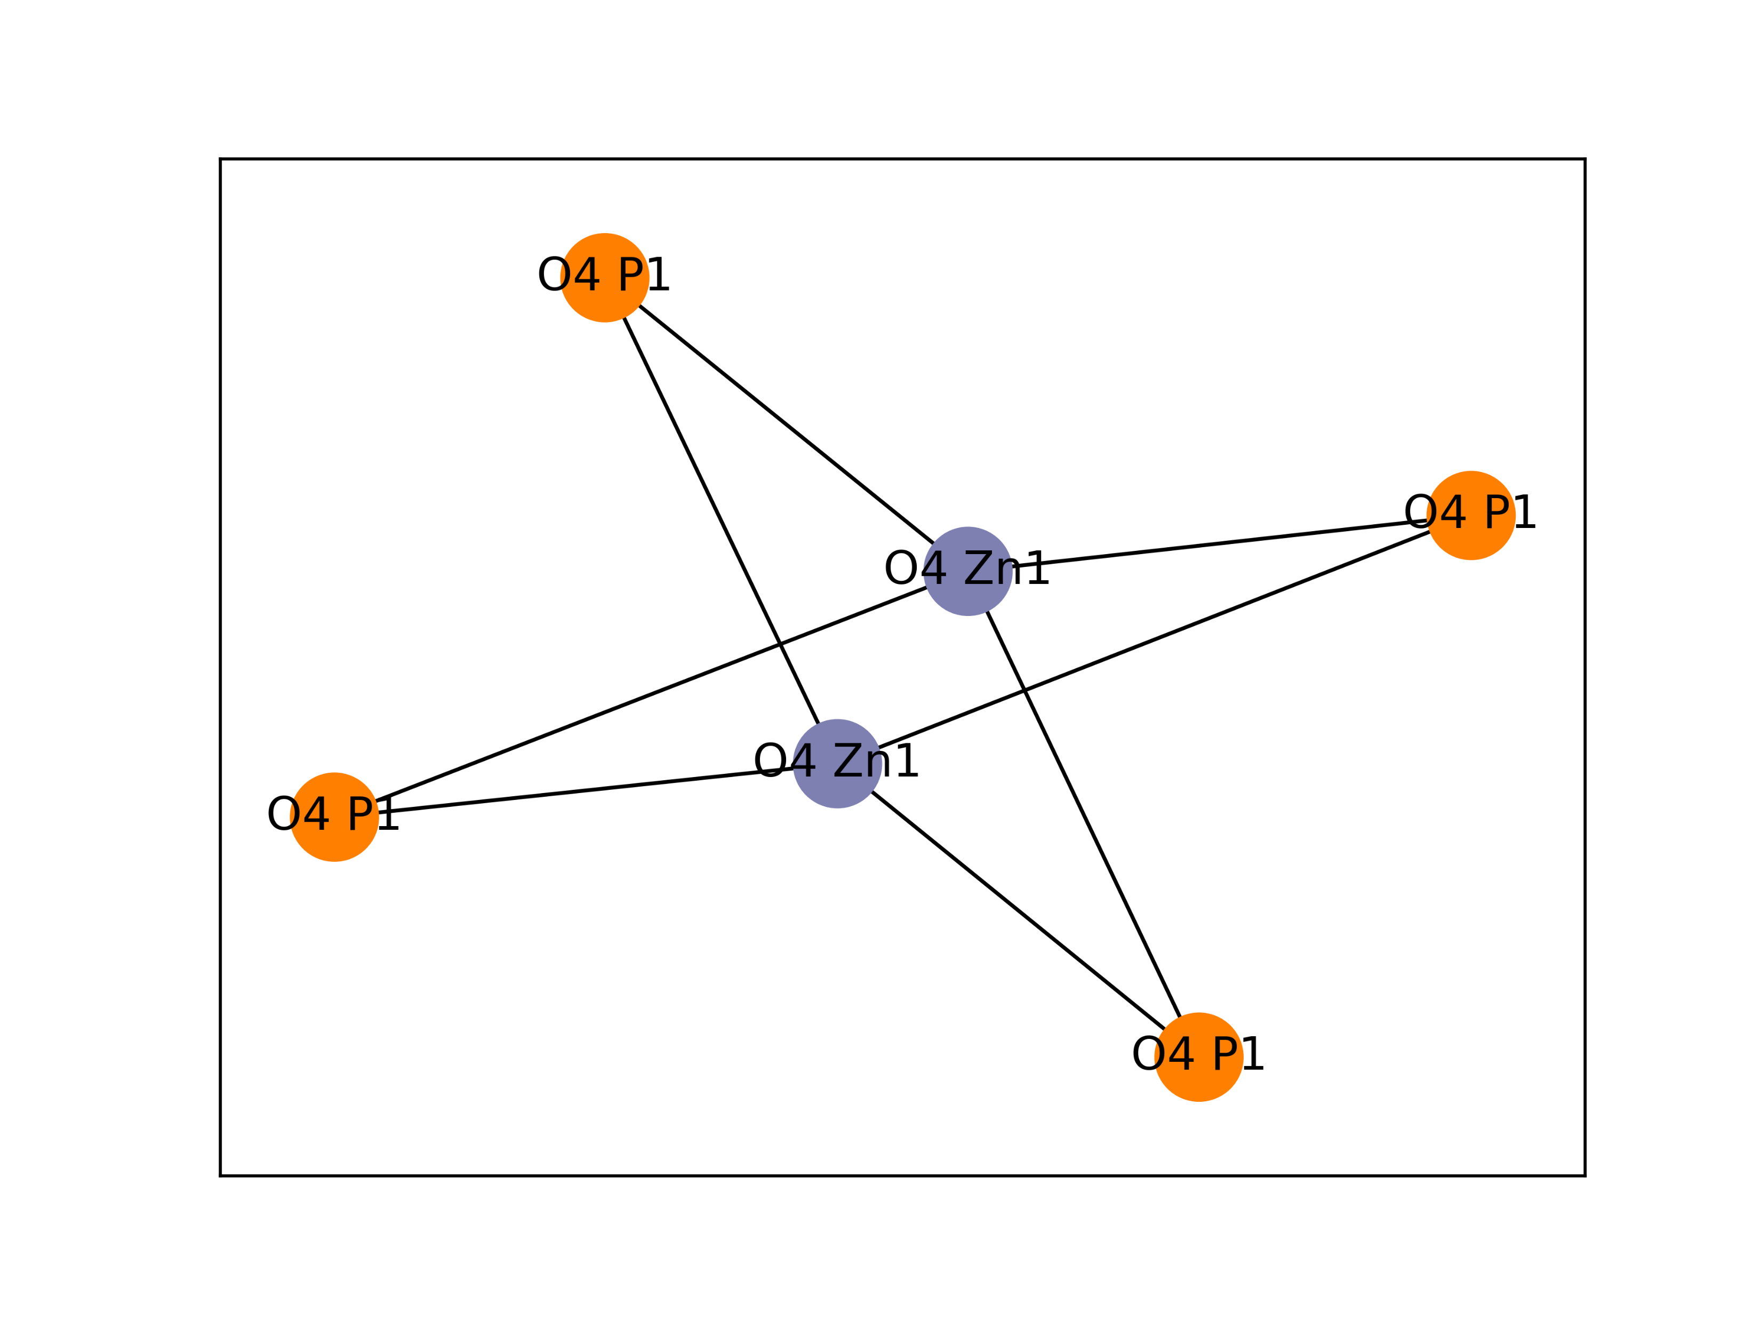
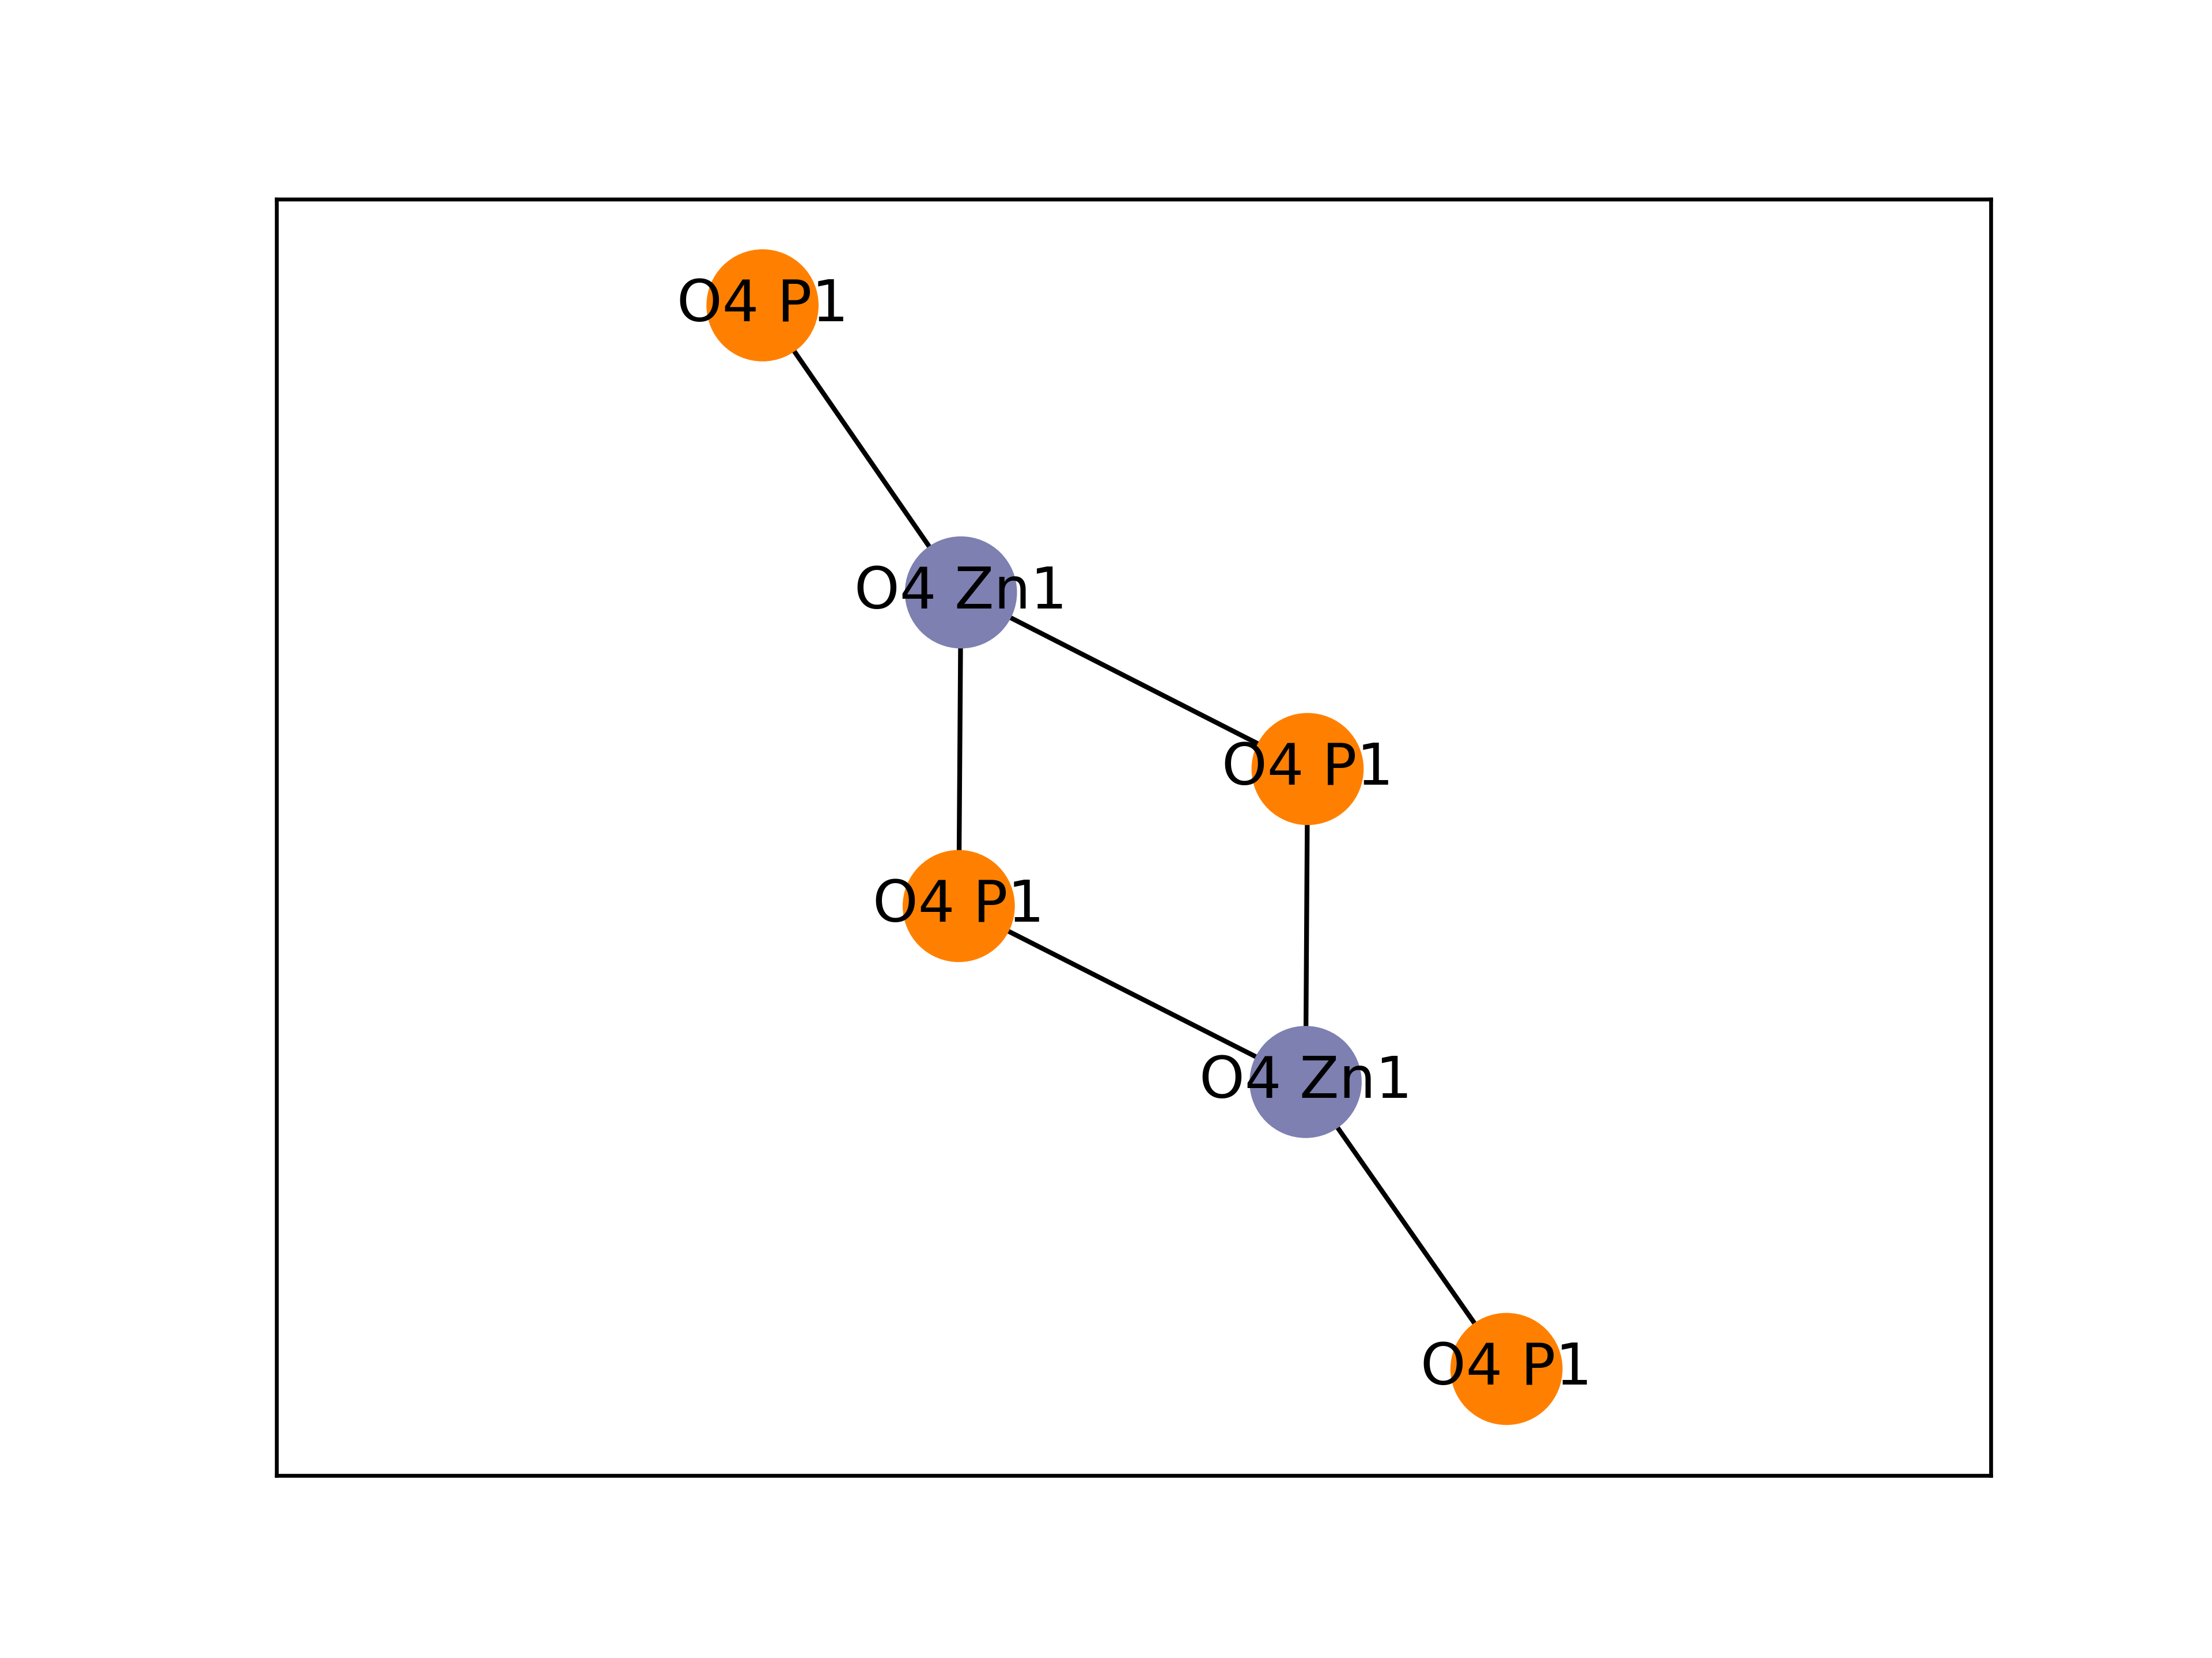
FAVWUW
AZONIM
XAKCUH

